Slide 1
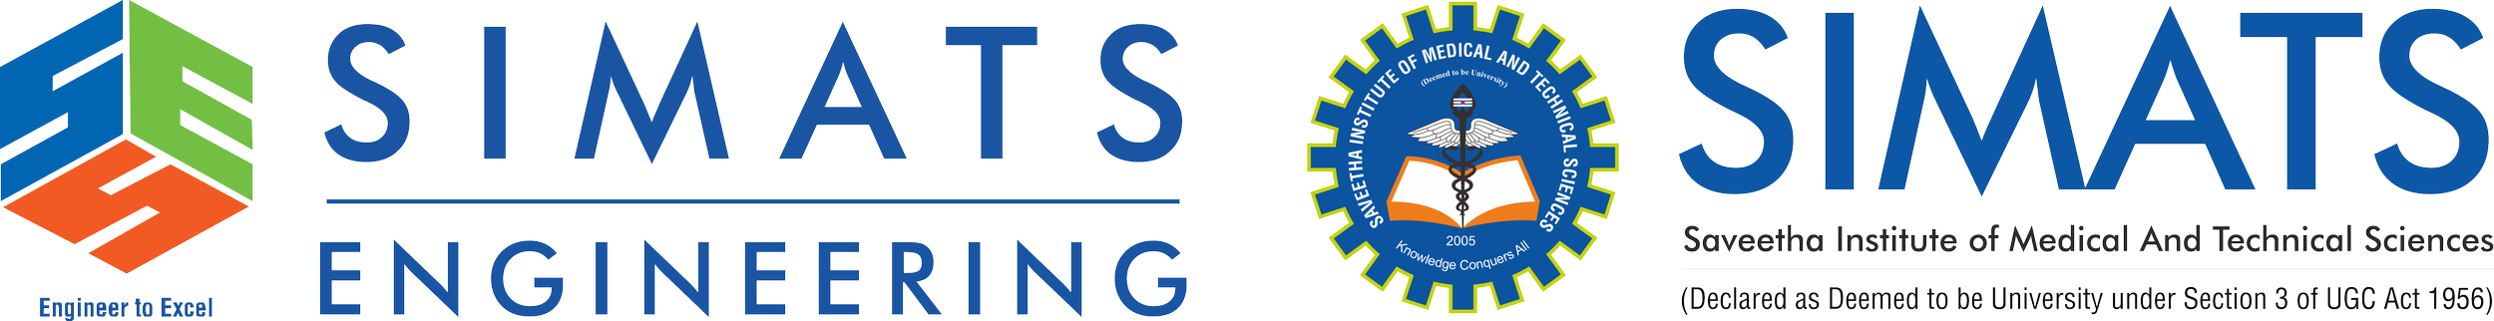
Porter Stemmer: Design, Working Mechanism, and Applications
Course: Natural Processing Language Course code: DSA0302
Guided By
Dr. T. Devi
Presented By
D. Sindhu (192424197)

Slide 2
Introduction to Porter Stemmer
What is Porter Stemmer?
Porter Stemmer is a rule-based stemming algorithm developed by Martin Porter (1980).
It removes suffixes from words to obtain their root (stem).
It is one of the most widely used stemming algorithms in Natural Language Processing (NLP).
Why is Stemming Needed?
Reduces different word forms to a common root.
Decreases vocabulary size.
Improves search accuracy and text processing efficiency.

Slide 3
Design & Working Mechanism
How Porter Stemmer Works
The algorithm removes suffixes through a sequence of rule-based steps.
Working Process:
Input Word
Apply Rules
Remove Suffix
Generate Stem

Slide 4
Example
Playing
Remove -ing
Play
Sentence:
The students were studying and playing games.
After Stemming:
The student were studi and play game.
Studies
Remove -ies
Studi

Slide 5
Porter Stemmer Rules
Suffix | Result
ing | playing → play
ed | walked → walk
ies | studies → studi
s | books → book
ly | quickly → quick

Slide 6
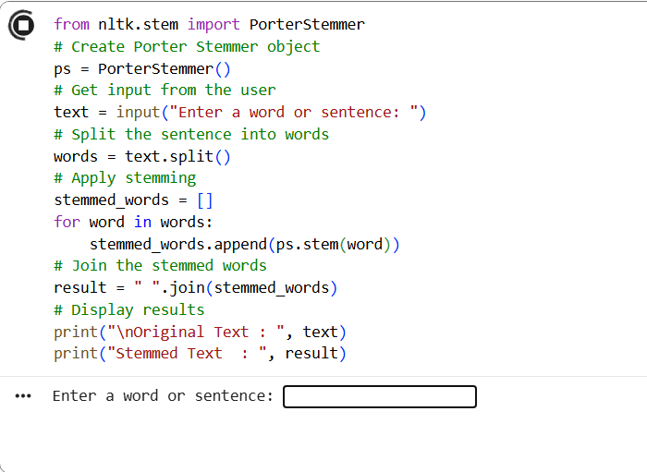
Implementation

Slide 7
Applications of Porter Stemmer
Information Retrieval Systems
Search Engines
Text Classification
Sentiment Analysis
Document Clustering
Chatbots
Spam Email Detection
Text Preprocessing in NLP

Slide 8
Limitations
Sometimes produces incorrect stems (Over-stemming)
Cannot understand word meaning or context
Rule-based approach may not work well for all languages
Best suited for English text
Overcoming Limitations
Modern NLP applications often combine
tokenization → POS tagging → lemmatization for more accurate text processing.

Slide 9
Conclusion
Porter Stemmer is a simple, fast, and widely used rule-based stemming algorithm in NLP.
It reduces words to their root form, improving text preprocessing, information retrieval, and search efficiency.
Although it may produce non-dictionary stems (e.g., studying → studi), its limitations can be overcome by using lemmatization, POS tagging, or advanced stemmers like Snowball Stemmer.
Porter Stemmer remains a fundamental technique and serves as the foundation for many modern NLP applications.

Slide 10
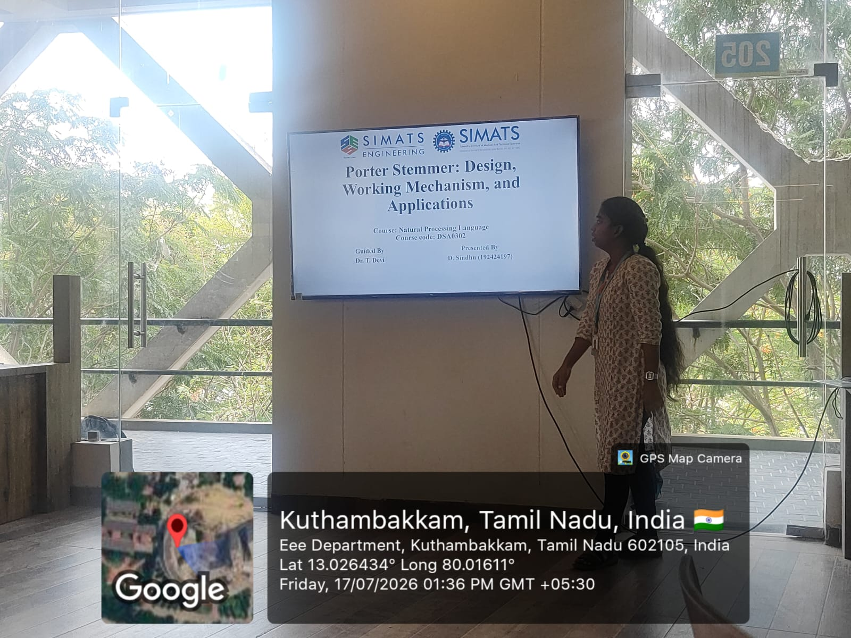
Geotag

